Slide 1


JAVA OOP
ITP64 - Integrative Programming and Technologies

Slide 2
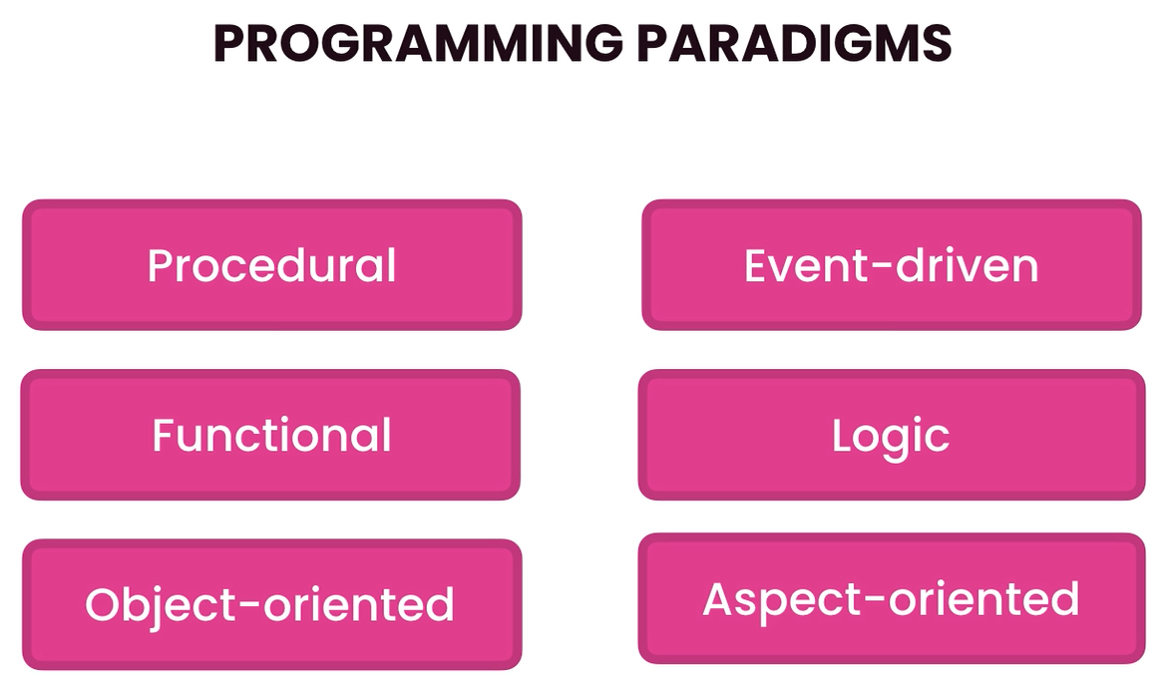
Programming Paradigms
- ways or syles of writing codes

Slide 3
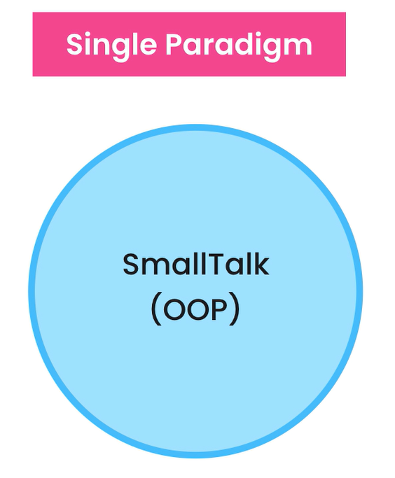
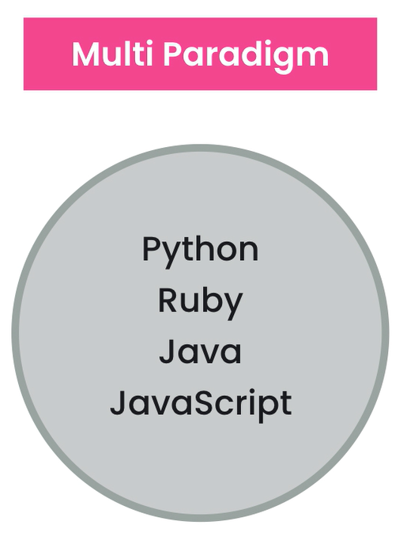
Programming Paradigms

Slide 4

In OOP, everything is based on the concepts of objects
Objects are units based on data(or state) and operations on data called methods(or behavior)
Object Oriented Programming

Slide 5
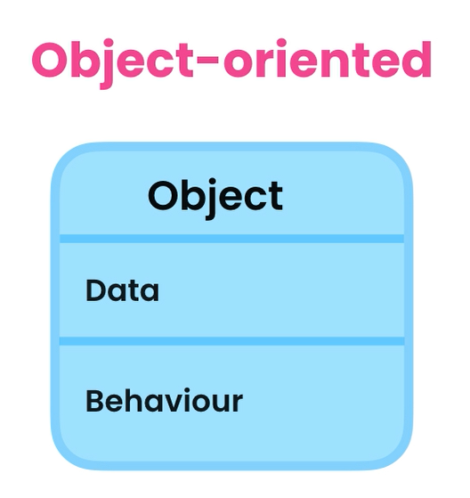
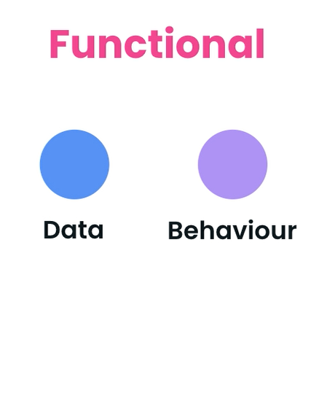
OOP vs Functional

Slide 6
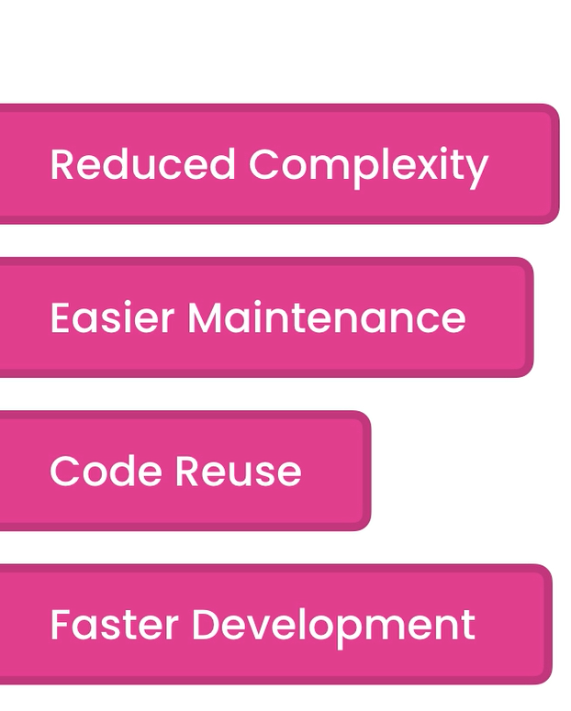
Benefits
breaking down a large complex application into smaller, manageable objects
if an object is not working properly, we can only focus fixing that object
more opportunity to reuse code in other applications
less time building applications

Slide 7
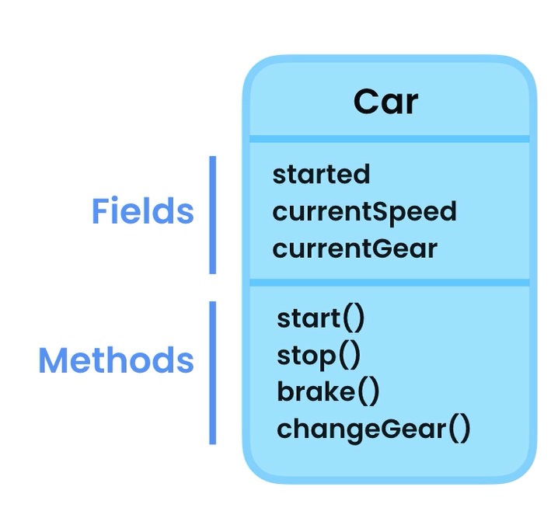
Classes and Objects
A class is a blueprint for creating objects
An object is an instance of a class
Car myCar = new Car();

Slide 8

Question
What state and behavior can a class TV have?

Slide 9
Creating classes
Creating objects
- use Pascal naming convention
- use nouns
- create class members
- create constructor/s
- create method/s
Syntax:
Object objName = new Object();

Slide 10
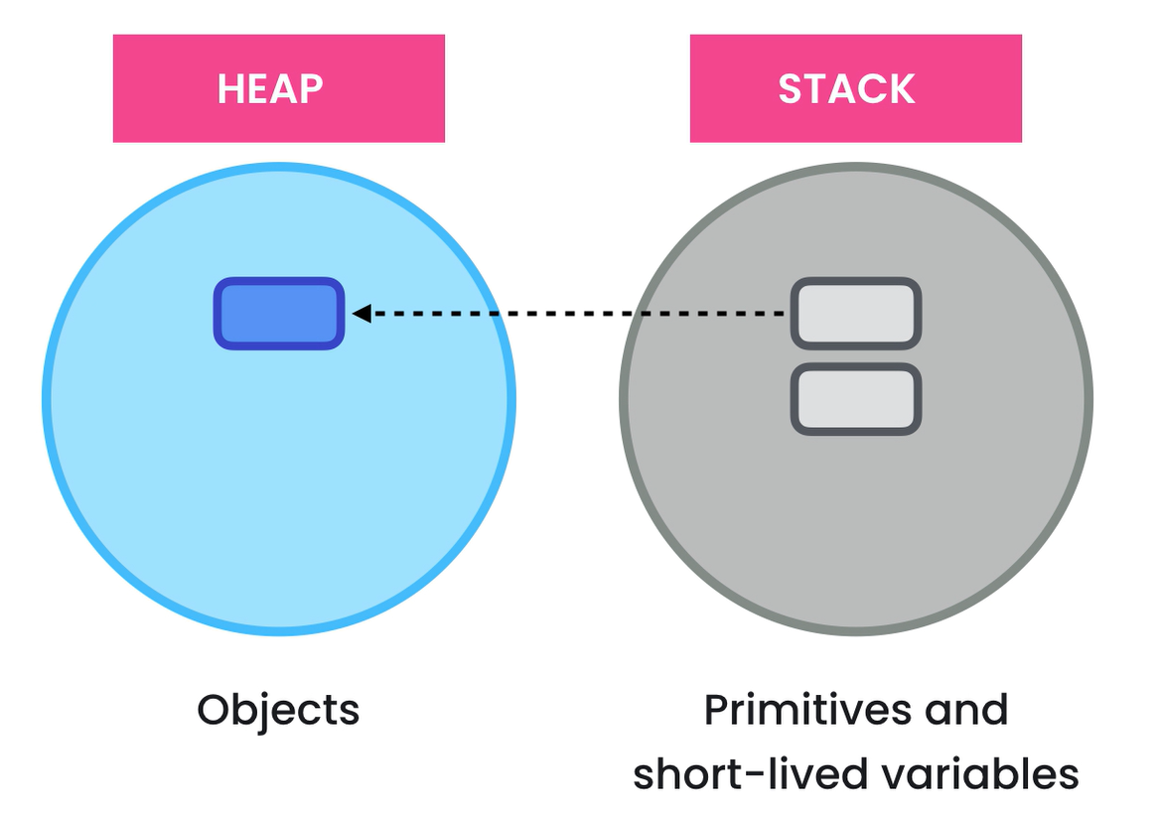
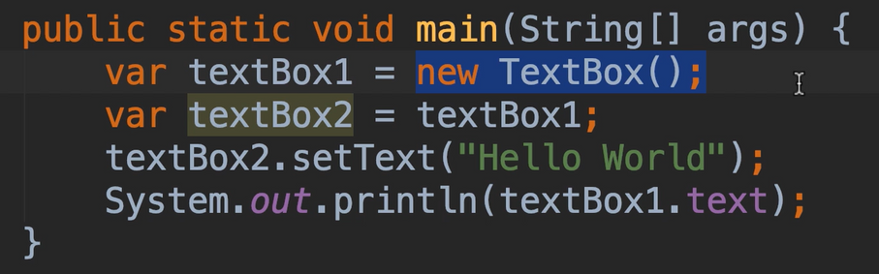
Memory Allocation

Slide 11
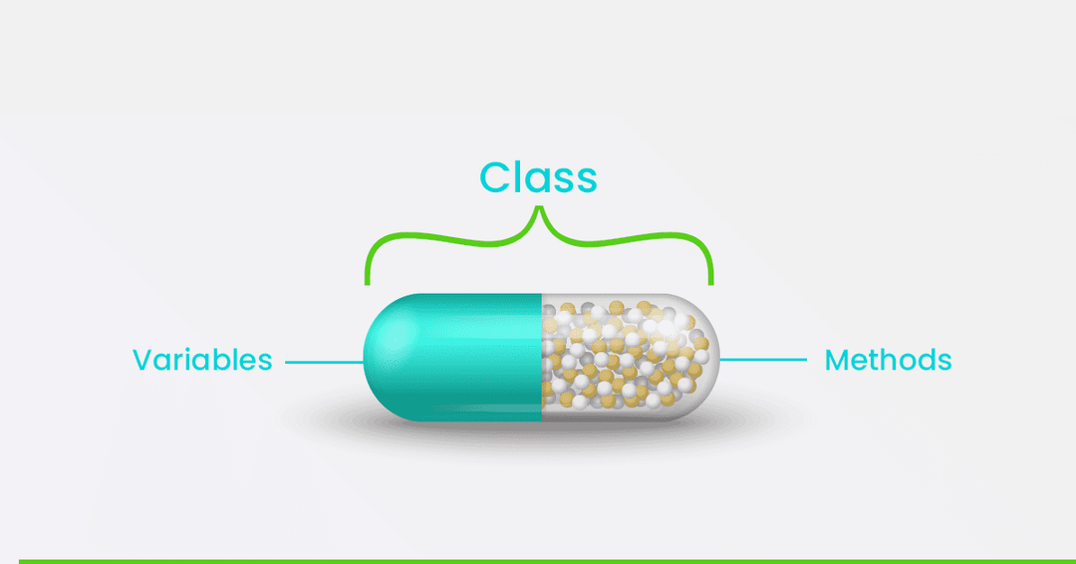
Encapsulation
Bundle the data and methods that operate on the data in a single unit
- make fields private
- use setters and getters to ensure that fields can only be accessed and altered only in the same class

Slide 12
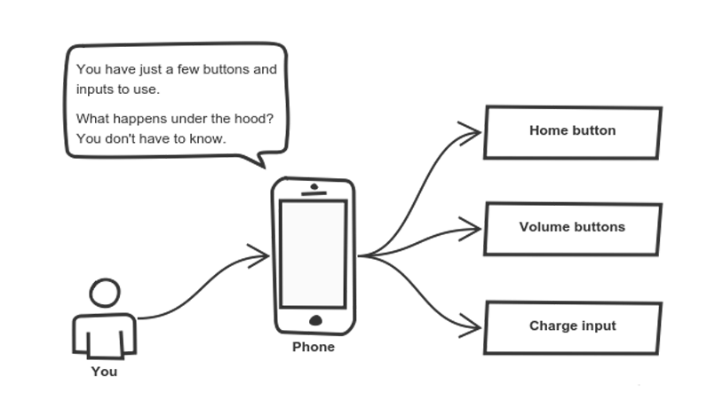
Abstraction
Reduce complexity by hiding unecessary details
Hides the implementation of a class and treat it as a blackbox

Slide 13
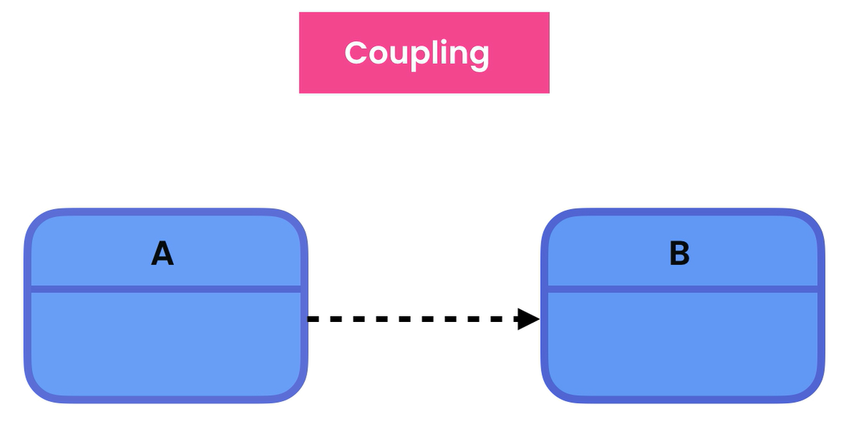
Coupling
The level of dependency between classes
The more classes are coupled to each other, the more costly channges will be

Slide 14

Constructors
A constructor in java is similar to a method that has no return type and with the same name as the class. This is used to create an instance of a class.
Constructors can be default, no-args or parameterized.
If a class is written without any constructor, it will provide a default constructor.
No-args constructors are constructors that have no arguments
Parameterized constructors are constructors with arguments

Slide 15

Constructor Overloading
Constructor overloading is the concept of having more than one constructor with different parameters so that every constructor can perform a different task
This can be done by having multiple constructors with different parameters
The this keyword refers to the current object in a method or constructor

Slide 16
Static Fields
Static Methods
Static Members
Use static fields where a value is independent of objects but needed to be shared on all objects of the same class.
Static methods can only see other static members of the same class.
In OOP, a class can have 2 types of members: instance and static. Members can be fields or methods
Why is the main method static?
Instance members belong to instances or objects.
Static class
A static class is a class that is created inside a class, is called a static nested class in Java. It cannot access non-static data members and methods. It can be accessed by outer class name.
This is to enable the Java runtime to directly call the main method without having to create an object
Static or class members belong to a class

Slide 17
Inheritance
In Java, Inheritance is the mechanism in Java by which one class is allowed to inherit the features(fields and methods) of another class.
In Java, Inheritance means creating new classes based on existing ones. A class that inherits from another class can reuse the methods and fields of that class. In addition, you can add new fields and methods to your current class as well.

Slide 18
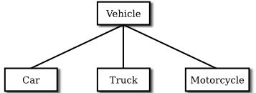
Inheritance
A class that is derived from another class is called a subclass (also a derived class, extended class, or child class).
The class from which the subclass is derived is called a superclass (also a base class or a parent class).
Excepting Object, which has no superclass, every class has one and only one direct superclass (single inheritance). In the absence of any other explicit superclass, every class is implicitly a subclass of Object.

Slide 19
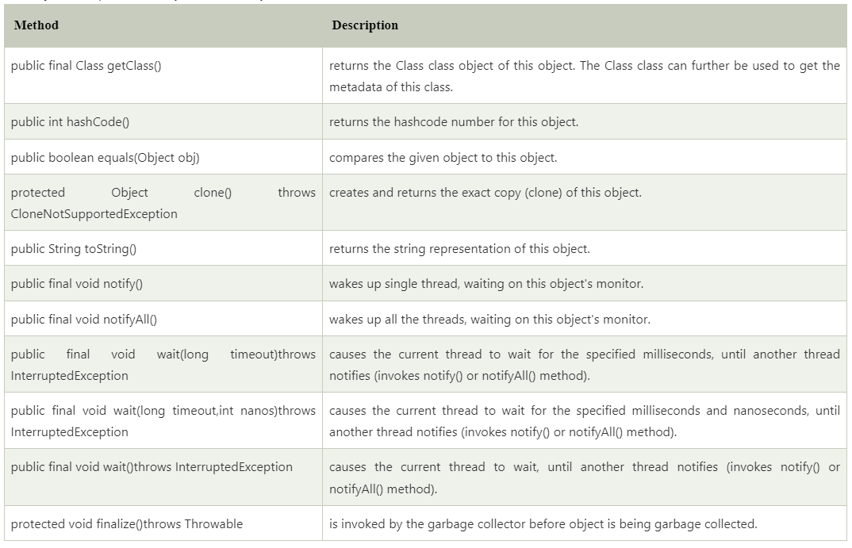
The Object class
This class consists of static utility methods for operating on objects. These utilities include null-safe or null-tolerant methods for computing the hash code of an object, returning a string for an object, and comparing two objects.

Slide 20
Constructor and Inheritance
The super keyword refers to superclass (parent) objects.
It is used to call superclass methods, and to access the superclass constructor.
The most common use of the super keyword is to eliminate the confusion between superclasses and subclasses that have methods with the same name.

Slide 21
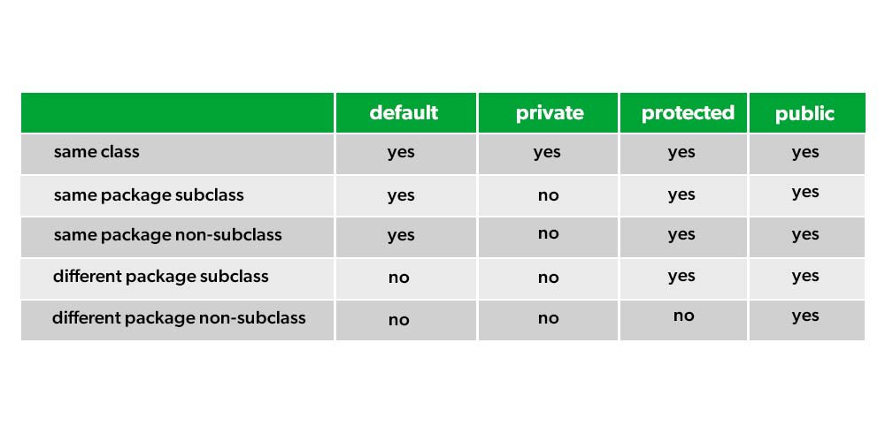
Access Modifiers
Private: The access level of a private modifier is only within the class. It cannot be accessed from outside the class.
Default: The access level of a default modifier is only within the package. It cannot be accessed from outside the package. If you do not specify any access level, it will be the default.
Protected: The access level of a protected modifier is within the package and outside the package through child class. If you do not make the child class, it cannot be accessed from outside the package.
Public: The access level of a public modifier is everywhere. It can be accessed from within the class, outside the class, within the package and outside the package.

Slide 22

Method Overriding
Override a method declared in a base class
Uses the @Override annotation

Slide 23
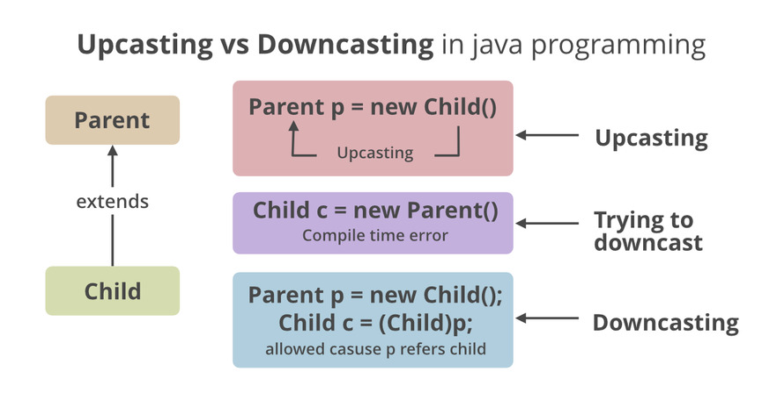

Slide 24
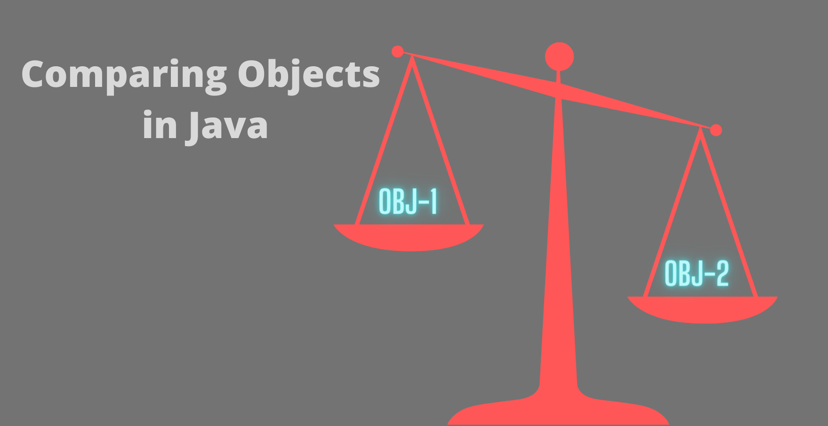

Slide 25
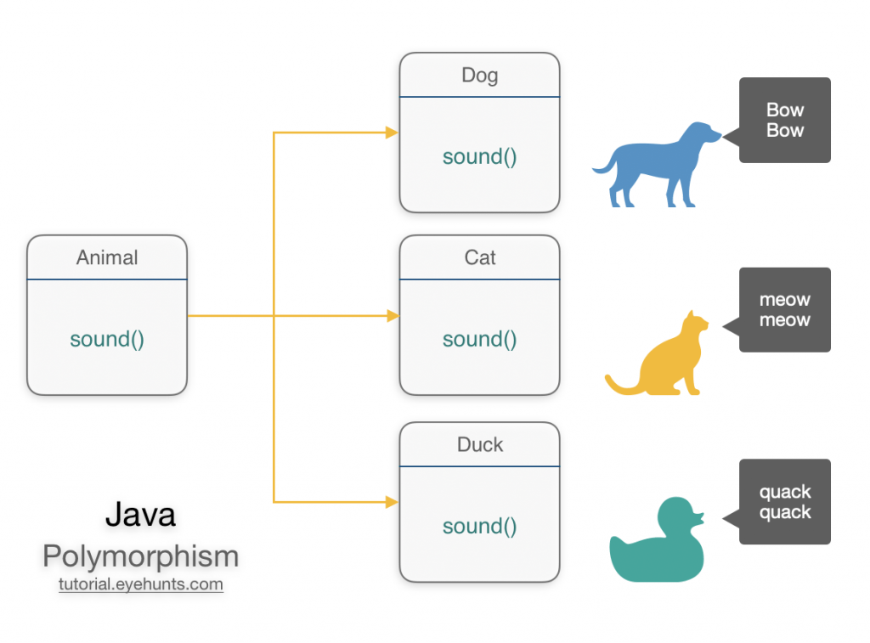
Polymorphism
Polymorphism means "many forms", and it occurs when we have many classes that are related to each other by inheritance

Slide 26
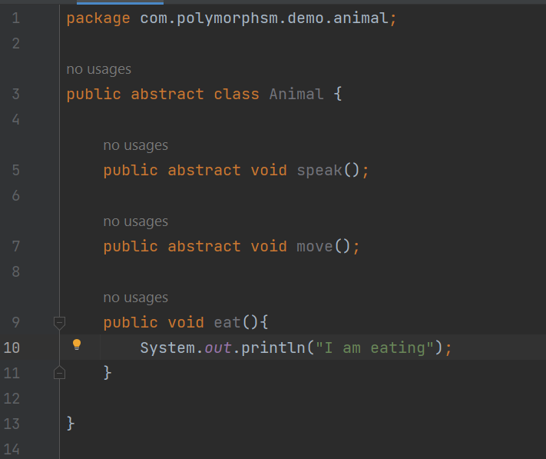
Abstract class and methods
Abstract class: is a restricted class that cannot be used to create objects (to access it, it must be inherited from another class).
Abstract method: can only be used in an abstract class, and it does not have a body. The body is provided by the subclass (inherited from).

Slide 27
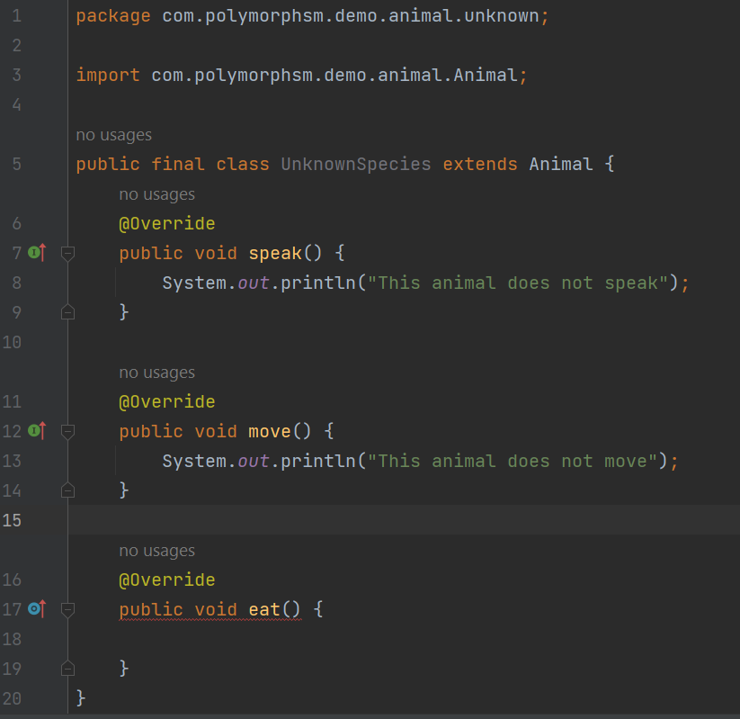
Final classes and methods
A final class is a class that cannot be extended anymore or cannot have a subclass
A final method is a method that cannot be overridden

Slide 28
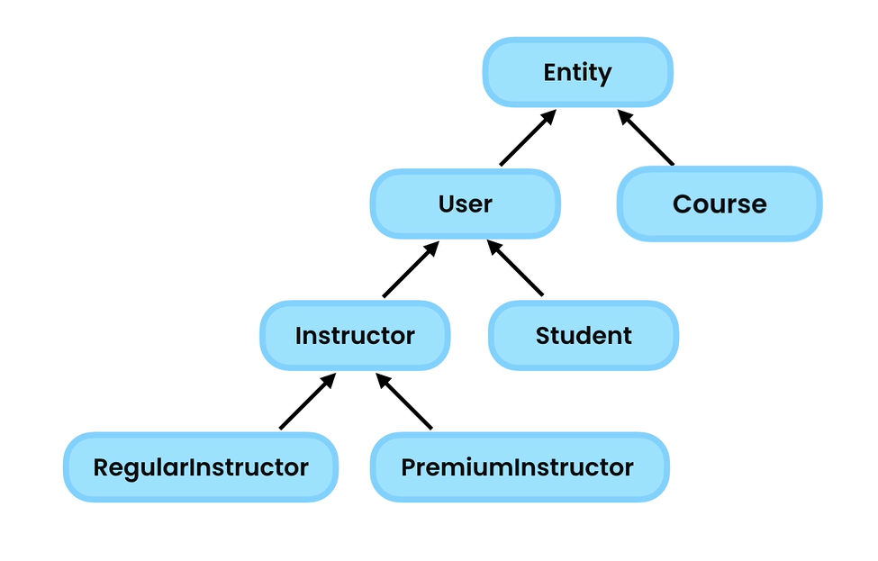
Deep Inheritance
As a general rule, deep inheritance must be avoided because classes that are involved in inheritance is tightly coupled

Slide 29
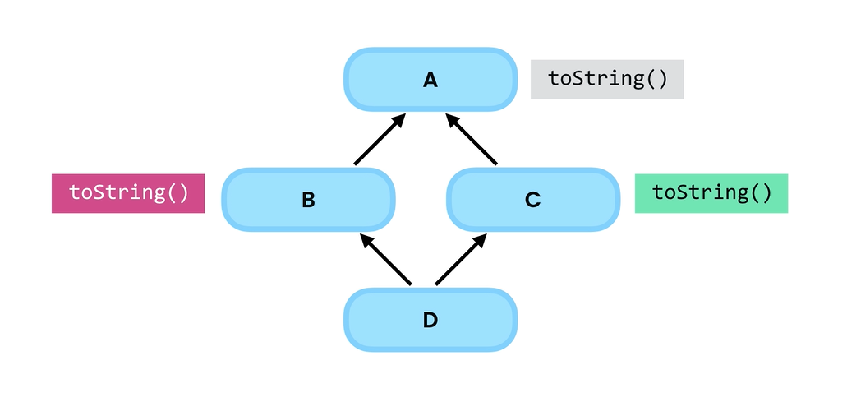
Multiple Inheritance
In java, only single inheritance is allowed.

Slide 30
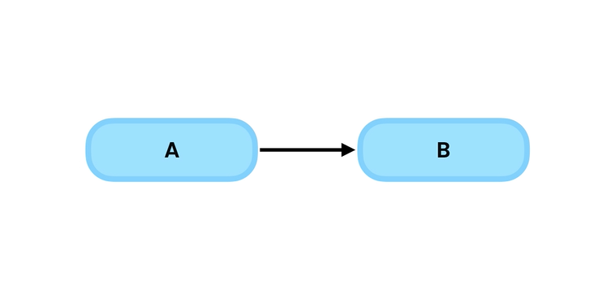


Interfaces
interfaces are used to build loosely-coupled, extensible, testable applications.
Abstraction hides the implementation details of classes and only expose what is necessary
An interface is a type similar to a class but only includes method declaration/ signatures and no implementation.

Slide 31
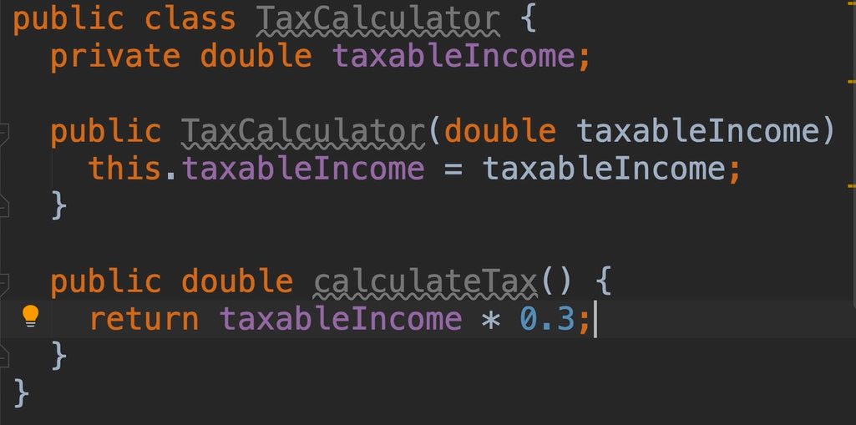
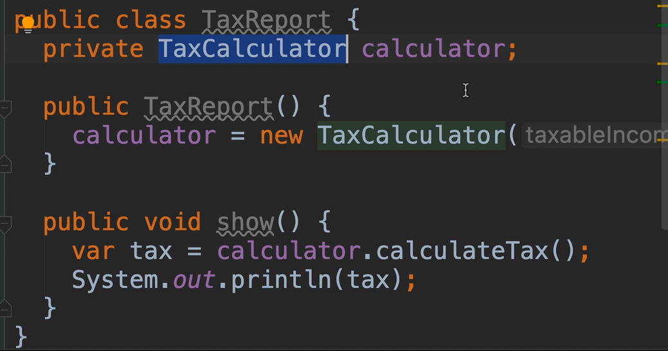
Tight Coupling

Slide 32
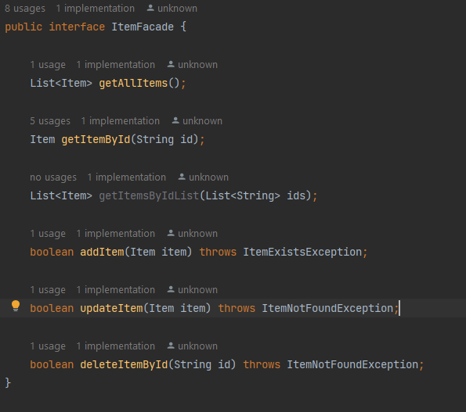
Using Interfaces

Slide 33
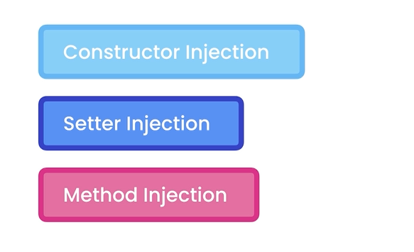
Dependency Injection
A dependency injection is a strategy that is used to separate the creation of dependency objects from the class that needs them.

Slide 34
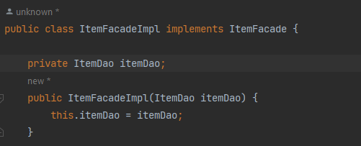
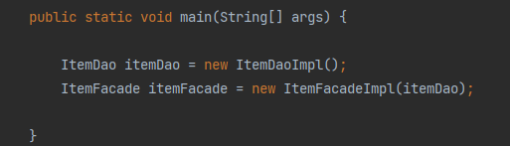
Constructor Injection

Slide 35
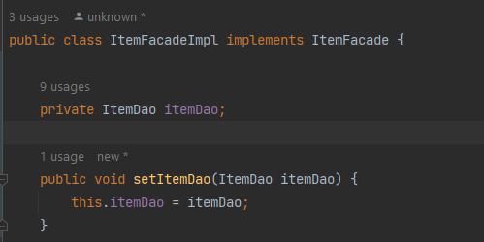
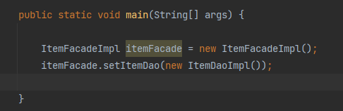
Setter Injection

Slide 36
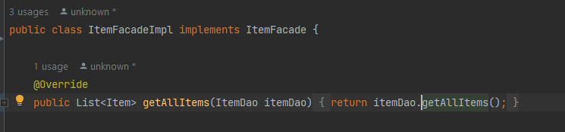
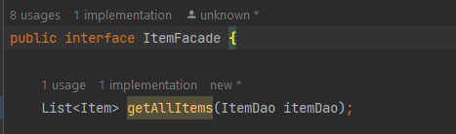
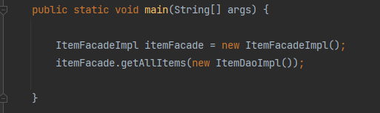
Method Injection

Slide 37
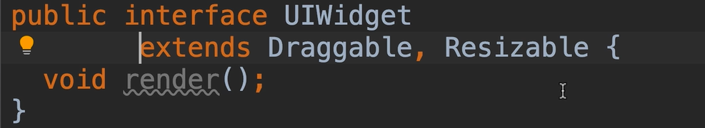
Interface Multiple Inheritance

Slide 38
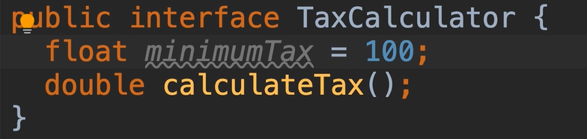
Fields in Interfaces

Slide 39
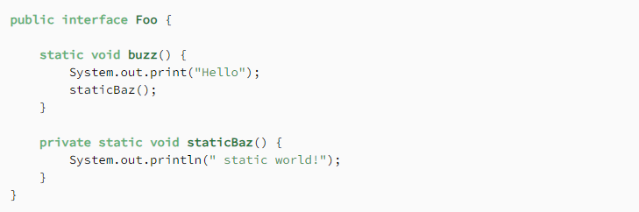
Bad Interface Features
Static Methods
Private Methods

Slide 40
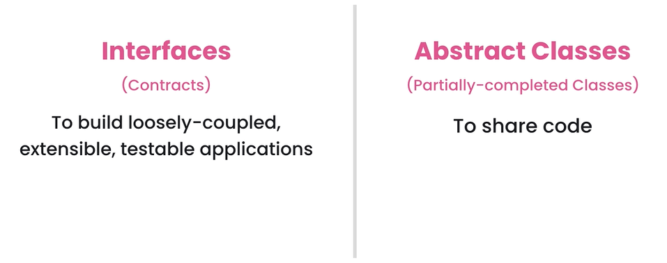
Interface vs Abstract class

Slide 41
Thank you!

